Slide 1

MODULE 9-10 PROJECT EXECUTION
Dittas Formoso

Slide 2
LEARNING OUTCOME
Understand what project execution is and what happens during project execution
Understand the challenges during project execution phase
Track actual vs. planned using the gantt chart
Know what is produced during project execution
7 strategies for a successful project execution

Slide 3
PROJECT BASELINE
A baseline in project management is a clearly defined starting point for your project plan. It is a fixed reference point to measure and compare your project’s progress against. This allows you to assess the performance of your project over time.

Slide 4
WHAT IS PROJECT EXECUTION
The project execution phase is usually the longest phase in the project life cycle; and the most demanding. In the project execution phase:
Your team carries out all the planned activities, constructs deliverables, and presents them to project stakeholders
Your focus, as a project manager changes to performing and supervising all activities to create deliverables as outlined in the project plan
You’ll need to continuously track the project’s progress and ensure that the milestones and deliverables stick to the project schedule

Slide 5
The 3 objectives of a project manager during the project execution:
Managing people
Managing processes
Managing communication

Slide 6
The benefits of a well-executed project are threefold:
The project can be completed on time and budget
Team morale can be maintained
Stakeholders are satisfied with overall project progress

Slide 7
What happens during the project execution phase
Execute the project scope
Manage the team’s work
Recommend changes and corrective actions
Manage project communication with stakeholders
Conduct team-building exercises
Celebrate project milestones and motivate team members
Hold status review meetings to make sure everything is on schedule
Document all changes to the project plan

Slide 8
What challenges are you likely to face?
A lack of common understanding
Uninvolved sponsors
Misalignment with strategic project objectives and goals
Poor change management processes
Ineffective corporate governance
Poor leadership

Slide 9
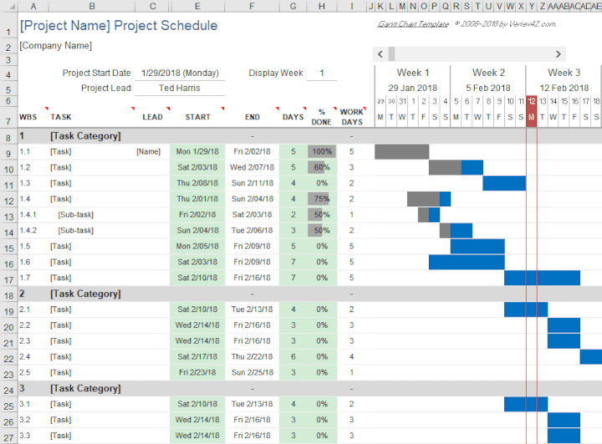

Slide 10
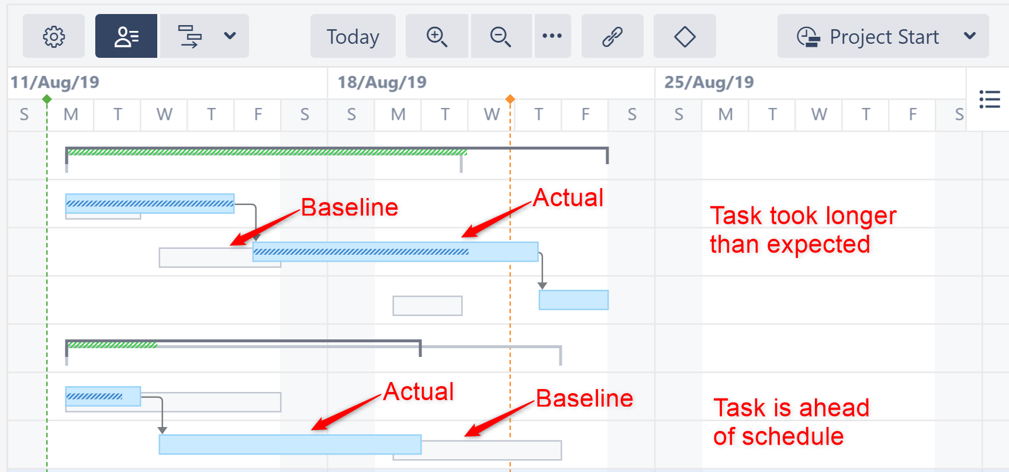

Slide 11
What’s produced during the execution phase?

Slide 12
Project Deliverables
Project deliverables are the tangible outputs of the project. They need to reviewed, tested, and meet the acceptance criteria given by the clients.

Slide 13
Change Requests
When client expectations change or there’s a disconnect between the team’s understanding of the client’s requirements, scope changes happen. These are documented in the change requests, which are then reviewed and approved

Slide 14
Performance Data
The execution stage produces a lot of data points that you can use to optimize your team’s performance. You can find where your team is spending most of their time and how you can cut down on time and costs.

Slide 15
Issues Log
Whenever there are bugs, issues, or defects, you document them in the issue log. This will help you get back to the issues and fix them.

Slide 16
Documentation updates
Any changes to the documents created during the planning phase like the project scope and project schedule will be documented.

Slide 17
7 strategies for a successful project execution

Slide 18
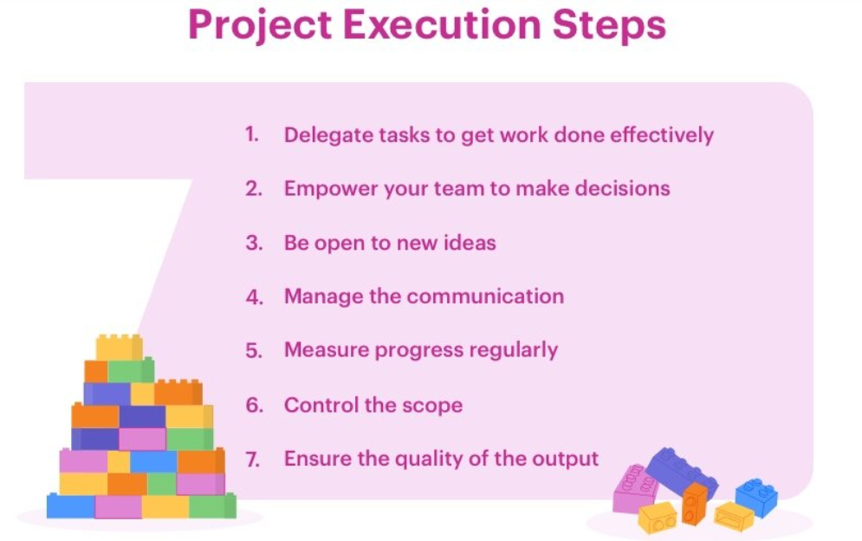

Slide 19
1) Leverage on the PM Tool
Using the right project management tool can be a major differentiating factor for your team.
The best tools on the market offer deep visibility into work status and reduce the need for manual tracking during the execution phase.
Additionally, they also provide the ability to generate periodic customs reports in an easily accessible manner.
At the end of the day, the right project tool for you is one that boosts your efficiency without the need to get past a steep learning curve.

Slide 20
2) Delegate tasks to get work done effectively
Task delegation does not mean that you let go of every aspect of the project and start depending on the team members.
Instead, it means that you enable your team and build their confidence by making them responsible for a small part of the project.
It can be a repetitive task or something you feel a particular member is better at

Slide 21
3) Empower your team to make decisions
An empowering environment is a sufficient motivator for team members that encourages them to go above and beyond. Give them enough authority to make decisions and take the necessary steps to fulfill the plan.

Slide 22
4) Be open to new ideas
It’s good practice to involve the team in making some decisions. Even if they suggest a different approach than what you had in mind, appreciate their input, and be flexible enough to accept better suggestions. This will serve as a good motivator and make the team feel valued and their contributions acknowledged.

Slide 23
5) Manage team communication
It’s the responsibility of the project manager to consistently maintain effective collaboration between the project team and the project stakeholders. You need to share the project’s progress with all stakeholders throughout this phase frequently.
Schedule periodic meetings with the project team to review the current status of the project. Discuss the next steps in the project, obstacles, and how to solve these problems during these meetings

Slide 24
6) Measure progress regularly
There’s no way to know if you’re staying on track if you aren’t measuring the project’s progress. Your project planning process included setting measurable goals and KPIs (key performance indicators). This is where all the effort you put into documentation comes in handy.
During the execution phase, risks may materialize. By continuously assessing the risks, you equip your team with contingencies and keep the project from failure.

Slide 25
7) Control the scope
Almost every project suffers from a nasty monster called Scope Creep. It is when the project slowly grows out of your control and beyond the project’s original scope.
You cannot and should not avoid all change requests. Most projects require you to iterate and adapt to change. Market conditions, client needs, organizational priorities can change and you need to deal with them

Slide 26
Bonus Point – Ensure the quality of output and deliverables with stakeholder
It’s always a good practice to make sure that you’ve translated the client’s expectations into the deliverable. Test those deliverables and see if they meet the acceptance criteria.
Once you have the deliverables ready, you’d schedule a formal phase review with all key stakeholders.
All deliverables are reviewed, accepted, and approved.
If there are any passable issues, they are documented along with their resolution plan and all relevant plans and documents are updated accordingly.

Slide 27
GROUP WORK
Review your project plan. Update the project plan to reflect completed activities.
Use the software tool of your choice to update the gantt chart.

